Slide 1
Data Fundamentals
CSC105
Prof. Earl
Notes:
Title Slide

Slide 2
Definition of data
“Data are values of qualitative or quantitative variables, belonging to a set of items.”
Set of items: Sometimes called the population; the set of objects you are interested in
Variable: A measurement or characteristic of an item.
Qualitative: Country of origin, sex, treatment
Quantitative: Height, weight, blood pressure reading
Adapted from Jeff Leek, Johns Hopkins School of Public Health
Notes:
Remind students of the definition of data literacy.
We begin to connect to the terms that we use when working with and describing data.
Note that Jeff uses the plural form of data. There are times when data can be used as singular and our language is evolving
https://www.onlinegrammar.com.au/top-10-grammar-myths-data-is-plural-so-must-take-a-plural-verb/

Slide 3
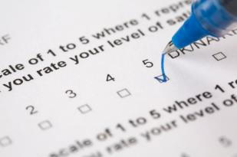
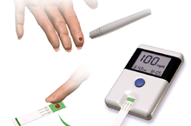
How Data Are Collected
Data can be collected in a variety of ways:
Questionnaire
Interview
Observation
Analysis of Documents
Web scraping
Machine measurements

Slide 4
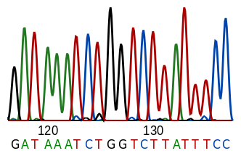
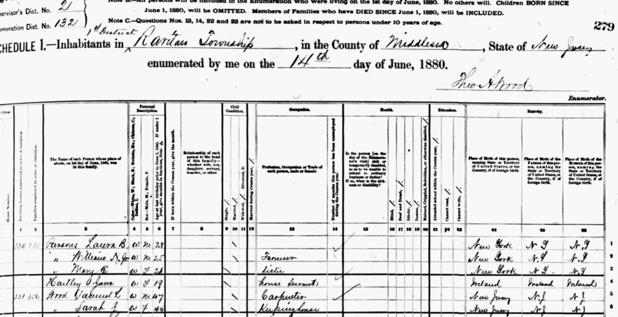
Raw data: The form that we receive or collect the data
The file your measurement machine gives you
Unformatted Excel file with 10 worksheets that the company you contracted with sent you
Complicated data file from scraping Twitter
Hand-entered numbers you collected from observations
Notes:
Refer to Elements of Data Style reading page 11.
Mention that “raw data is relative” and depends on the situation.

Slide 5
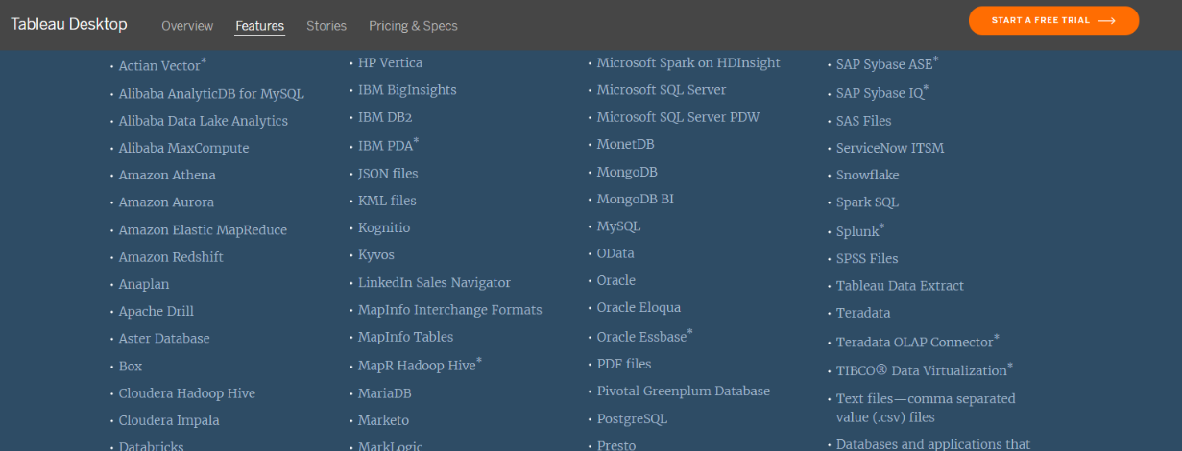
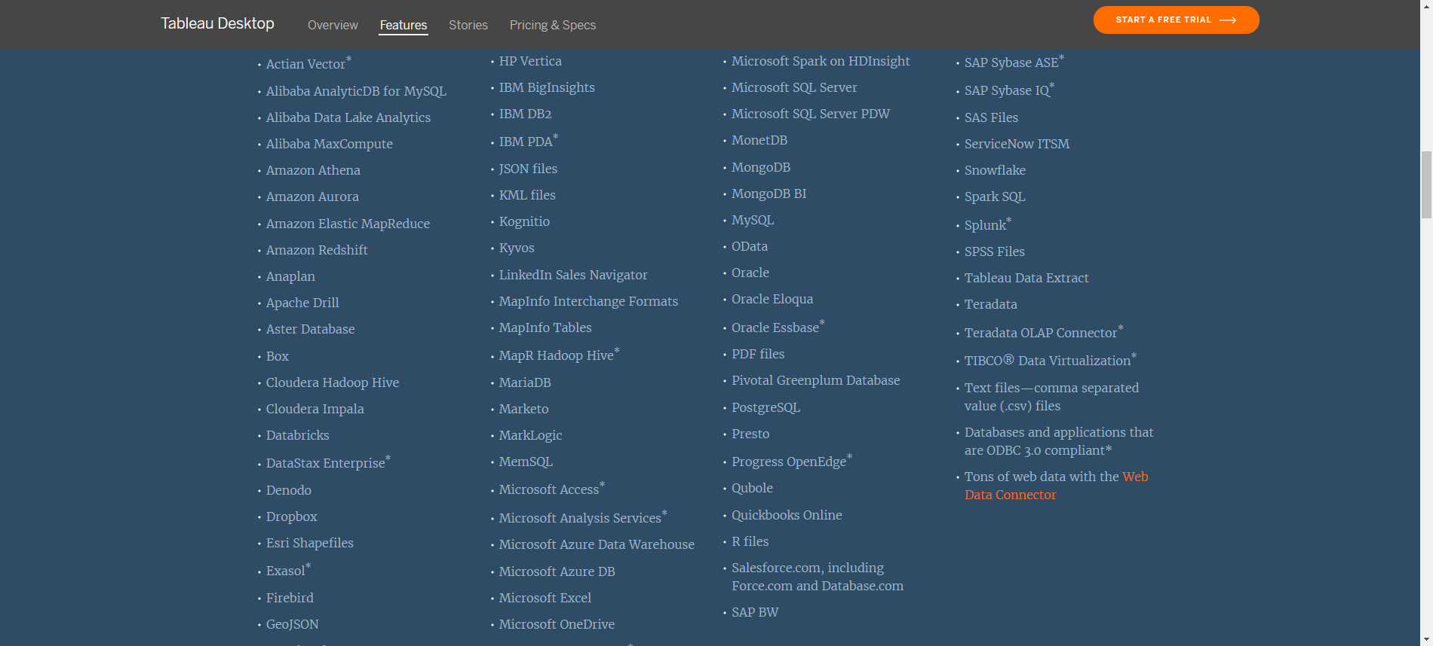
Many types of data sources
Notes:
Comment: want to make this slide easier to read.
From our website: https://www.tableau.com/products/desktop?_ga=2.152332283.350376687.1578950597-123116840.1560793840&_fsi=kj4bIexc#data-sources

Slide 6
Characteristics of Data
High Volume
Historical
Consistent
Multivariate
Atomic
Clean
Clear
Dimensionally Structured
Richly Segmented
Of known Pedigree
Notes:
Discuss Stephen Few’s reading here. Ask students how having these characteristics help us ask great questions.

Slide 7
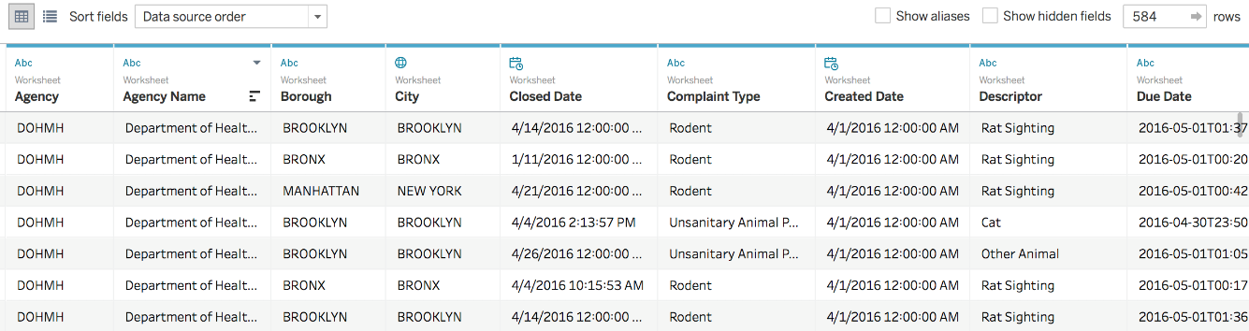
How do we organize data?
Rows (across)
Each row represents on unit of analysis
Columns (down)
Each column represents a different variable (or field)
Notes:
Tip for beginner students: If you have students who are very new to data, have them create a dataset on the board by having them list Name, height, eye color, favorite movie, or other variables. The act of physically making a dataset can help students remember the concept.

Slide 8
Tidy Data
Each variable should be in one column
Each different observation of that variable should be in a different row
There should be one table for each kind of variable
If you have multiple tables, they should include a column in the table that allows them to be joined
Notes:
Note: the italicized bullets will not be covered in this course but are part of the definition of tidy data. Students who will be moving on to programing materials in future coursework will need to be aware of these characteristics of tidy data.

Slide 9
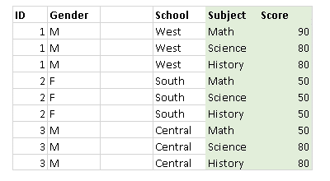
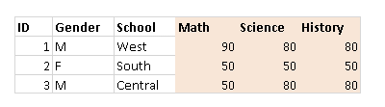
Example: individual observations are in rows and columns
Row Oriented
Column Oriented
Notes:
Discuss example in Tips for working with data: https://help.tableau.com/current/pro/desktop/en-us/data_tips.htm

Slide 10
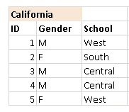
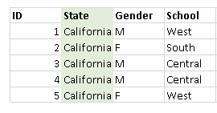
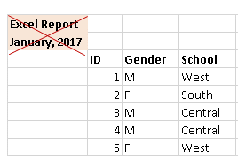
Watch out for extra rows and columns
Notes:
Discuss example in Tips for working with data: https://help.tableau.com/current/pro/desktop/en-us/data_tips.htm

Slide 11
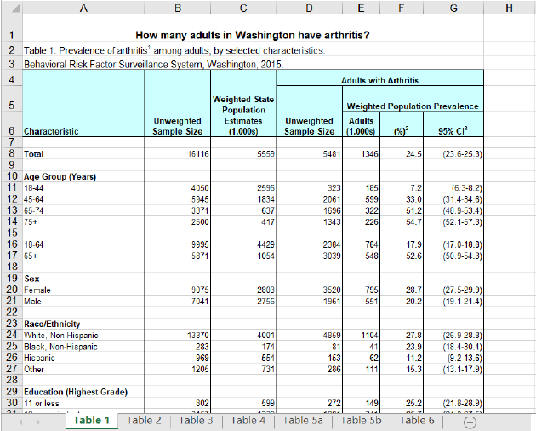
Watch out when working with excel
Notes:
Ask students to name all that is wrong with this file and why the file is not a real “dataset”.
Use as in-class activity:
1) Have them first work on their own
Discuss in pairs or groups
Whole class discussion
Example answers: Many titles in differing rows. Should have headings in first row only.
Subtitles (such Age Group, Sex, Race) in first column that are variables
Highlighted cells will not be read by most software programs, including Tableau

Slide 12
Notes:
Tableau Logo

